Slide 1
Day 1:- C Programming
Today's Session We cover
--What is Programming Language
--Define Computer Program
--Number System
--Types of Software
--List the component of computer required to execute a program
--Define an algorithms
--Write algorithms for solution of a given problems.
--Draw flowchart for solution of a given problems.
--State different programming languages.
--What is Translators
--Program Development Environment

Slide 3
What is Programming Language
Are Classified into two type:
1)Low Level Language
i.e.Machine Level Language
2)High Level Language

Slide 4
Define Computer Program
Program is a set of instructions
Given in a particular sequence
Having a predefined meaning
E.g:-
An instruction is a combination of some words. Which have a predefined meaning.
Instructions are given in a particular sequence.
C=a+b
Display c
instruction

Slide 5
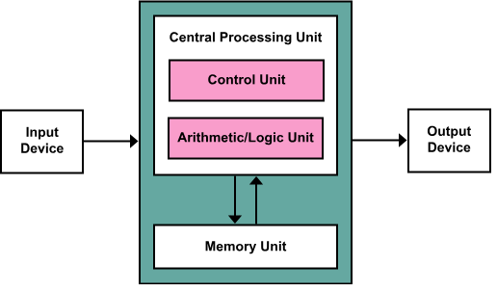
Programming Instructions
A Computer has two inseparable parts:-
Hardware and Software

Slide 6
Programming Instructions
The instructions are the software
The physical component of a computer that are used in the process are hardware.

Slide 7
Why Number System:-
a,b and c are numbers
C=a+b
Display c
Input as well as output have to be understood by the computer and the user respectively
A number system plays an important role so that the same instructions can be manipulated by giving different numbers as input.

Slide 8
Number System:-
Way of counting things
Computer use different types of number systems.
1.Decimal(base 10)
2.Binary(base 2) 0 1
3.Octal(base 8)
4.Hexadecimal(base 16)

Slide 9
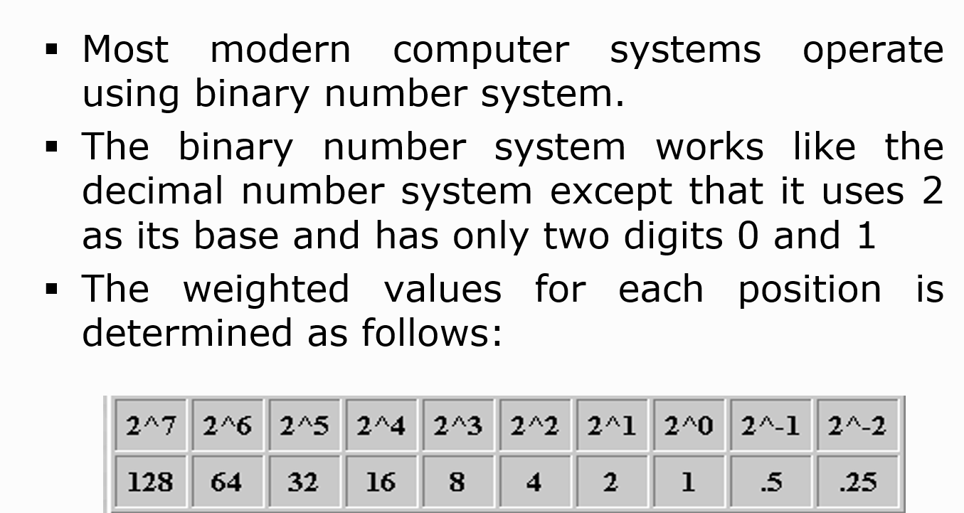
Binary Number System:-

Slide 10
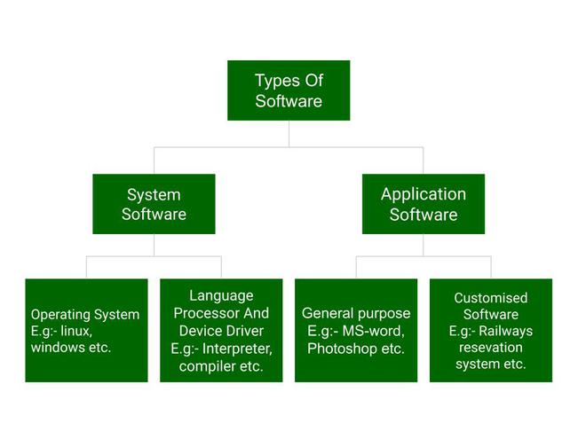
Types of Software

Slide 11
Algorithm:
----The word Algorithm means “a process or set of rules to be
followed in calculations or other problem-solving operations”.
-----Therefore Algorithm refers to a set of rules/instructions
that step-by-step define how a work is to be executed upon
In order to get the expected results.

Slide 12
Flowchart:-
A flowchart is the graphical or pictorial representation of an algorithm with the help of different symbols, shapes, and arrows to demonstrate a process or a program. With algorithms, we can easily understand a program. The main purpose of using a flowchart is to analyze different methods. Several standard symbols are applied in a flowchart:
The symbols above represent different parts of a flowchart. The process in a flowchart can be expressed through boxes and arrows with different sizes and colors. In a flowchart, we can easily highlight certain elements and the relationships between each part.

Slide 13
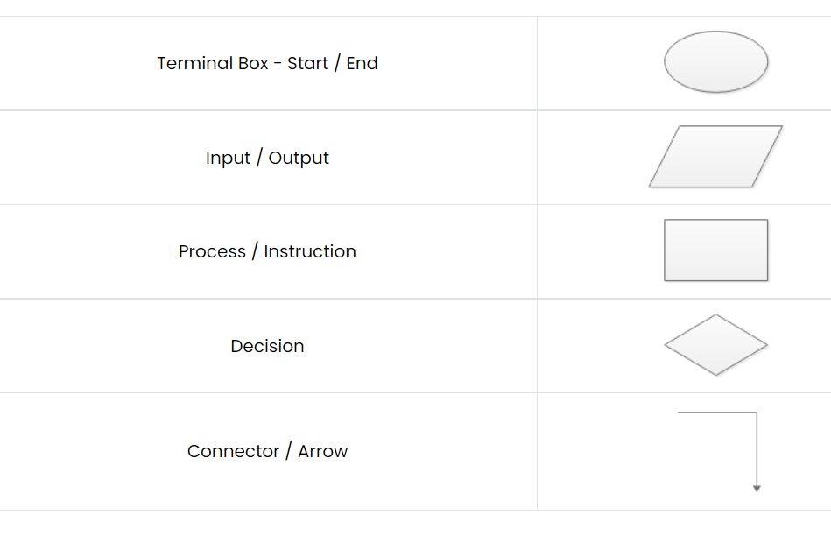
Flowchart & Symbols:-

Slide 14
Difference between Algorithm and Flowchart
Algorithm | Flowchart
Algorithm is the step-by-step instruction to solve a specific problem. | Flowchart is a pictorial representation to show the algorithm using geometrical diagrams and symbols.
Difficult to understand compared to flowcharts | Easier to understand
Complex representation of branching and looping | Easy representation of branching and looping
Easy debugging of errors | Difficult debugging of errors
Does not follow any rules to write | Has certain predefined rules of construction

Slide 15
Thank You

